Slide 1
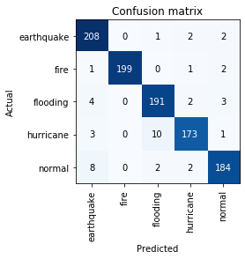
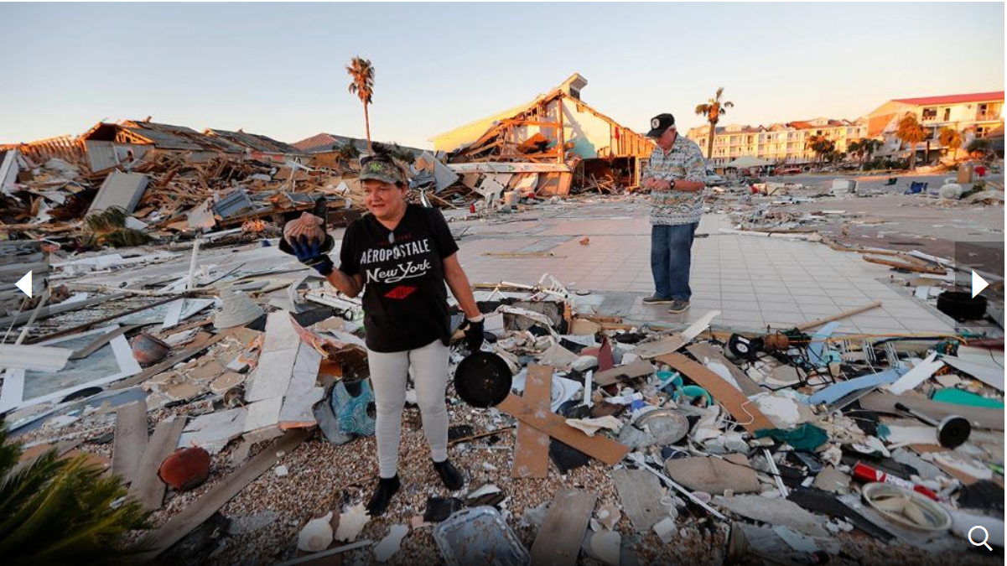

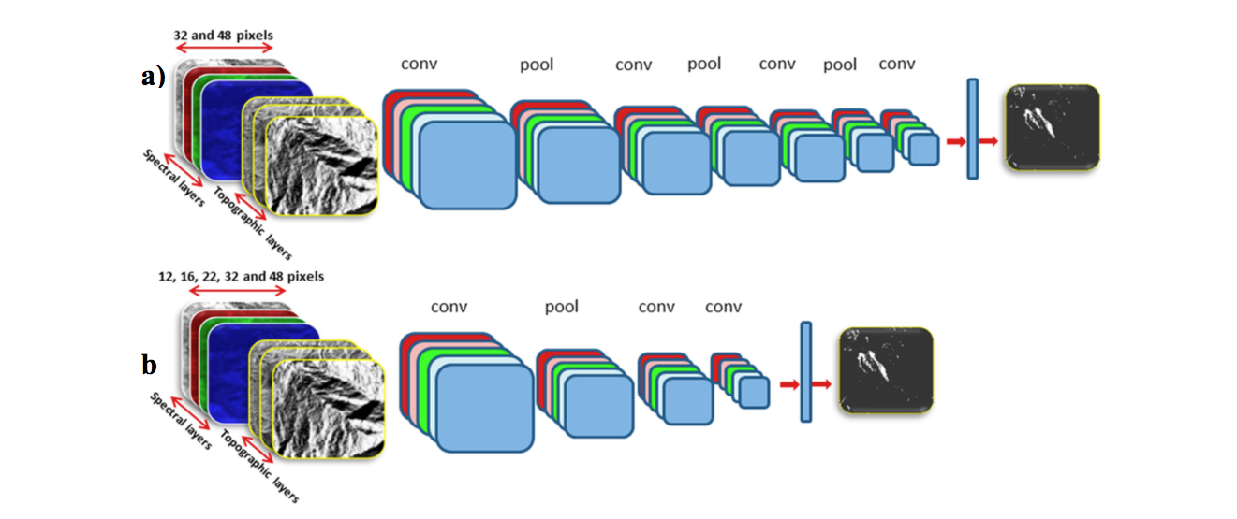
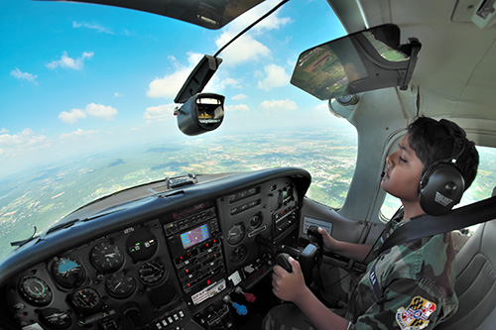
Background
Disaster Autotations
Computer Systems Research Lab
Dr. Gabor and Dr. White
January 24, 2020
By Joseph S. Lee
And Connor Grimberg
Website:
streamlit2.sites.tjhsst.edu
Results
Within the last 20 years, natural disasters have killed 1.3 million people and impacted 4.4 billion people, and 56% have been caused by earthquakes and tsunamis. Costs to recover from these disasters have risen 151%. While these stats are alarming, they may potentially be on the rise in the future, as the rate of natural disasters continues to grow. As a result of this eminent danger, disaster response has grown as a field. The federal government has become involved with the establishment of the Federal Emergency Management Agency (FEMA), whose primary job is to give funding to disaster team organizations. One such organization is the Civil Air Patrol (CAP). CAP is a non-profit, public service organization focused around carrying out emergency services and disaster relief mission nationwide while serving as a supplement to the United States Air Force. Their other two specializations include aerospace education in support of STEM-related careers and a cadet program to transform the American youth into leaders and aerospace engineers with fitness
and character.
CAP trains American soldiers to fly aircraft to take representative aerial photos of areas surrounding natural disasters for the purposes of disaster assessment and potentially to figure out which locations have priority status in resource allotment (e.g. how many people are sent, how much food is sent, and how much time is spent there.)
Our CNN ended up having a 4.40% error. This means that there is a 95.6% probability that our CNN classifies a given image correctly.
This confusion matrix shows the results of one testing session of our CNN to determine its general accuracy. For example, out of all earthquake photos tested to the CNN, 208 out of the 208 + 0 + 1 + 2 + 2 = 213 images were classified correctly by the CNN, and the rest of the numbers in that correspondent row shows how many earthquake photos did our CNN classify as another disaster type.
Methodology
This photo ^^ shows the aftermath of Hurricane Michael in Mexico Beach, Fla.
Saturday, October 13th, 2018.
Conclusion and Discussion
Overall, we were pleasantly surprised with the results of our CNN training. Reaching down to a mere 4.40% error was quite the feat. During the first training session, the CNN reached down to a 30% error and stagnated at that level. However, on the second training session, it decreased down to 13% in a linear fashion, then magically reached down to 4.40% error. We were quite skeptical of this result, but after extensive testing, the percentage error truly demonstrated itself.
This ^^ is a Civil Air Patrol pilot in action.
My partner and I implemented an Artificial Intelligence setup where the input is a folder of images taken on aerial aircraft of a certain disaster, and the output is annotations of each photo inputted, such as whether there is building damage, damaged vegetation, and people waving and crying for help. The A.I. technique we implemented is known as a Convolutional Neural Network (CNN). Essentially, it works by training on certain data imagery so that it can learn to recognize various, subtle, and nuanced patterns in certain types of images to classify relevant details in them correctly. In this case, our CNN learned to recognize the type of disaster in each image (i.e. whether the photo is normal or has one of the following disasters: earthquake, flooding, fire, or hurricane.)
References
AllGov. (2016). Federal Emergency Management Agency (FEMA). Retrieved January 24, 2020, from http://www.allgov.com/ website: http://www.allgov.com/departments/department-of-homeland-security/federal-emergency-management-agency-fema?agencyid=7345
Associated Press. (2018, October 15). United Nations Report Says 1.3 Million Killed by Natural Disasters in Last 20 Years as Costs of Climate Disasters Rise Dramatically [Press release]. Retrieved from https://weather.com/science/environment/news/2018-10-15-united-nations-earthquakes-tsunamis-climate-disasters#3
Civil Air Patrol. (n.d.). Cadet Flying. Retrieved January 24, 2020, from https://www.gocivilairpatrol.com/ website: https://www.gocivilairpatrol.com/programs/cadets/activities/cadet-flying
Civil Air Patrol. (n.d.). WHO WE ARE. Retrieved January 24, 2020, from https://www.gocivilairpatrol.com/ website: https://www.gocivilairpatrol.com/about/who-we-are
Motivation
Lives are on the line here; every second counts in a disaster response. I believed that Artificial Intelligence had potential to speed up the disaster response. More specifically, I envisioned an autonomous system (i.e. drones or any autonomous aircraft) can then leverage that Artificial Intelligence to detect priority locations for disaster teams such as the Civil Air Patrol to go, based on the interest of maximizing the number of people saved. Currently, humans have be the ones analyzing the state of a disaster in aircraft and in the ground for further inspection, but this can cause harm, especially for inspectors on the ground. Autonomy can therefore bring in further safety for disaster response as well.

Slide 2

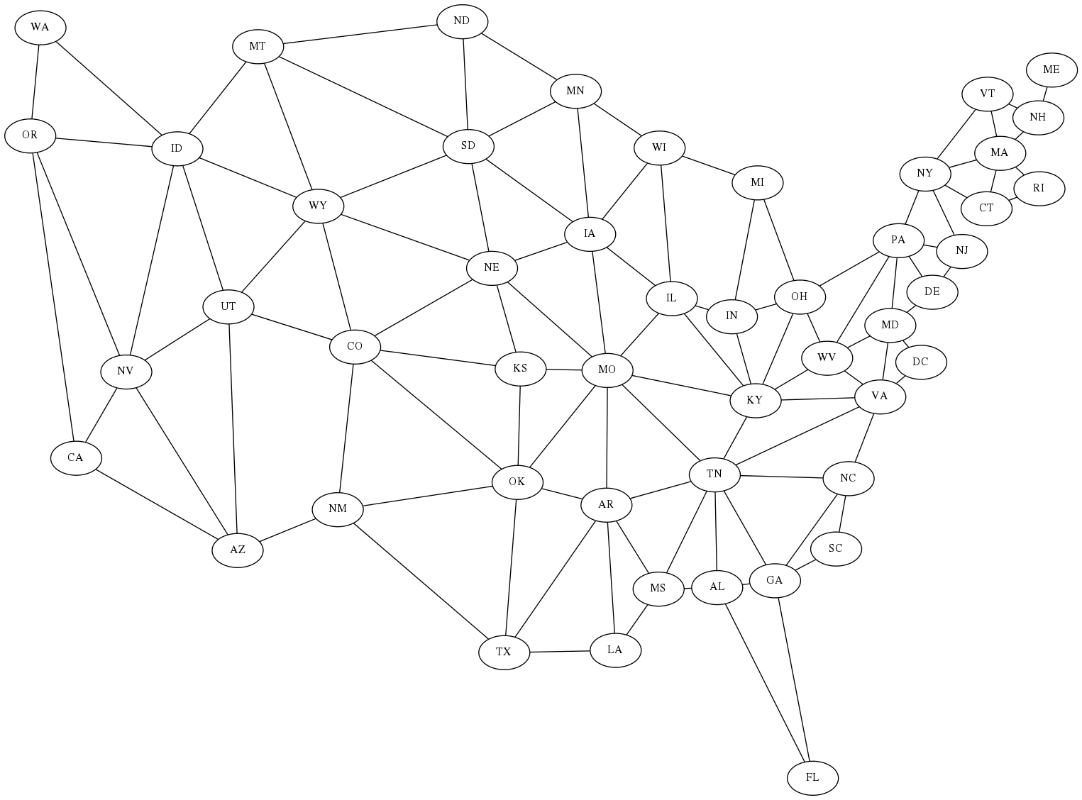



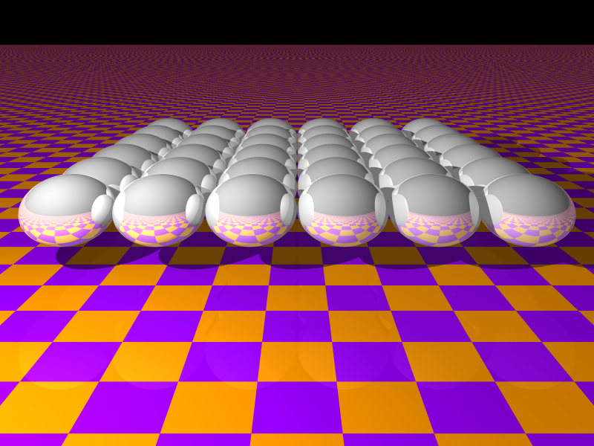
Artificial Intelligence
Parallel Computing
Graph node edge neighbor
Heuristic search shortest path
Efficiency heap priority queue
Recursion constraint solvers
Minimax game tree pruning
C pointer array memory tree
Manager worker MPI rank
Send receive data parameter
Nearest neighbor coupling
Grid 2-d interactive OpenGL
Welcome to the
Computer Systems Lab
www.tjhsst.edu/compsci
Image processing pixel color
Threshold edge angle shapes
Optimization local global scale
Evolutionary algorithm iterative
Neural network layers learning
Ray tracing 3-d render scene
Particle to particle interaction
Field solver cellular automata
Cache miss and false sharing
XMT OpenMP threads CUDA

